Slide 1
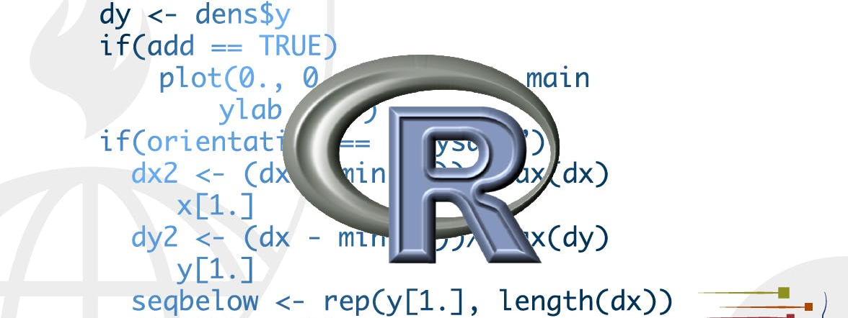
Modeling in R
STA 4233 Introduction to Programming and Data Management in R
Notes:
Now that you are equipped with powerful programming tools we can finally return to modelling. You’ll use your new tools of data wrangling and programming, to fit many models and understand how they work. The focus of this book is on exploration, not confirmation or formal inference. But you’ll learn a few basic tools that help you understand the variation within your models.
The goal of a model is to provide a simple low-dimensional summary of a dataset. Ideally, the model will capture true “signals” (i.e. patterns generated by the phenomenon of interest), and ignore “noise” (i.e. random variation that you’re not interested in). Here we only cover “predictive” models, which, as the name suggests, generate predictions. There is another type of model that we’re not going to discuss: “data discovery” models. These models don’t make predictions, but instead help you discover interesting relationships within your data. (These two categories of models are sometimes called supervised and unsupervised, but I don’t think that terminology is particularly illuminating.)

Slide 2
Introduction
Visualize
Import
Tidy
Transform
Communicate
Model
Understand
Program
Notes:
Data science is a huge field, and there’s no way you can master it by taking a course or reading a single book. The goal of this course is to give you a solid foundation in the most important tools. Our model of the tools needed in a typical data science project looks something like this:

Slide 3
Modeling in R
In model basics, you’ll learn how models work mechanistically, focusing on the important family of linear models.
In model building, you’ll learn how to use models to pull out known patterns in real data.
In many models, you’ll learn how to use many simple models to help understand complex datasets.
Notes:
This course is not going to give you a deep understanding of the mathematical theory that underlies models. It will, however, build your intuition about how statistical models work, and give you a family of useful tools that allow you to use models to better understand your data:
In model basics, you’ll learn how models work mechanistically, focusing on the important family of linear models. You’ll learn general tools for gaining insight into what a predictive model tells you about your data, focusing on simple simulated datasets.
In model building, you’ll learn how to use models to pull out known patterns in real data. Once you have recognized an important pattern it’s useful to make it explicit in a model, because then you can more easily see the subtler signals that remain.
In many models, you’ll learn how to use many simple models to help understand complex datasets. This is a powerful technique, but to access it you’ll need to combine modelling and programming tools.
These topics are notable because of what they don’t include: any tools for quantitatively assessing models. That is deliberate: precisely quantifying a model requires a couple of big ideas that we just don’t have the space to cover here. For now, you’ll rely on qualitative assessment and your natural skepticism. In Learning more about models, we’ll point you to other resources where you can learn more.

Slide 4
Hypothesis generation vs. hypothesis confirmation
Each observation can either be used for exploration or confirmation, not both.
You can use an observation as many times as you like for exploration, but you can only use it once for confirmation.
Notes:
In this book, we are going to use models as a tool for exploration, completing the trifecta of the tools for EDA that were introduced in Part 1. This is not how models are usually taught, but as you will see, models are an important tool for exploration. Traditionally, the focus of modelling is on inference, or for confirming that an hypothesis is true. Doing this correctly is not complicated, but it is hard. There is a pair of ideas that you must understand in order to do inference correctly:
Each observation can either be used for exploration or confirmation, not both.
You can use an observation as many times as you like for exploration, but you can only use it once for confirmation. As soon as you use an observation twice, you’ve switched from confirmation to exploration.
This is necessary because to confirm a hypothesis you must use data independent of the data that you used to generate the hypothesis. Otherwise you will be over optimistic. There is absolutely nothing wrong with exploration, but you should never sell an exploratory analysis as a confirmatory analysis because it is fundamentally misleading.

Slide 5
confirmatory analysis
60% of your data goes into a training (or exploration) set.
20% goes into a query set.
20% is held back for a test set.
Notes:
If you are serious about doing an confirmatory analysis, one approach is to split your data into three pieces before you begin the analysis:
60% of your data goes into a training (or exploration) set. You’re allowed to do anything you like with this data: visualise it and fit tons of models to it.
20% goes into a query set. You can use this data to compare models or visualisations by hand, but you’re not allowed to use it as part of an automated process.
20% is held back for a test set. You can only use this data ONCE, to test your final model.
This partitioning allows you to explore the training data, occasionally generating candidate hypotheses that you check with the query set. When you are confident you have the right model, you can check it once with the test data.
(Note that even when doing confirmatory modelling, you will still need to do EDA. If you don’t do any EDA you will remain blind to the quality problems with your data.)
STOP

Slide 6

Model basics
Notes:
The goal of a model is to provide a simple low-dimensional summary of a dataset. In the context of this book we’re going to use models to partition data into patterns and residuals. Strong patterns will hide subtler trends, so we’ll use models to help peel back layers of structure as we explore a dataset.
However, before we can start using models on interesting, real, datasets, you need to understand the basics of how models work. For that reason, this chapter of the book is unique because it uses only simulated datasets. These datasets are very simple, and not at all interesting, but they will help you understand the essence of modelling before you apply the same techniques to real data in the next chapter.

Slide 7
two parts to a model
define a family of models that express a precise, but generic, pattern that you want to capture.
generate a fitted model by finding the model from the family that is the closest to your data
y = a_1 * x + a_2
y = 3 * x + 7
Notes:
There are two parts to a model:
First, you define a family of models that express a precise, but generic, pattern that you want to capture. For example, the pattern might be a straight line, or a quadratic curve. You will express the model family as an equation like y = a_1 * x + a_2 or y = a_1 * x ^ a_2. Here, x and y are known variables from your data, and a_1 and a_2 are parameters that can vary to capture different patterns.
Next, you generate a fitted model by finding the model from the family that is the closest to your data. This takes the generic model family and makes it specific, like y = 3 * x + 7 or y = 9 * x ^ 2.

Slide 8
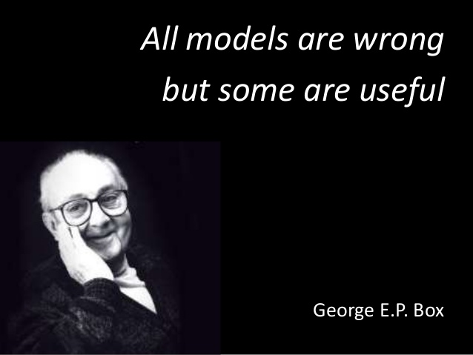
Model basics
Now it would be very remarkable if any system existing in the real world could be exactly represented by any simple model. However, cunningly chosen parsimonious models often do provide remarkably useful approximations. For example, the law PV = RT relating pressure P, volume V and temperature T of an “ideal” gas via a constant R is not exactly true for any real gas, but it frequently provides a useful approximation and furthermore its structure is informative since it springs from a physical view of the behavior of gas molecules.
For such a model there is no need to ask the question “Is the model true?”. If “truth” is to be the “whole truth” the answer must be “No”. The only question of interest is “Is the model illuminating and useful?”.
- George Box
Notes:
It’s important to understand that a fitted model is just the closest model from a family of models. That implies that you have the “best” model (according to some criteria); it doesn’t imply that you have a good model and it certainly doesn’t imply that the model is “true”. George Box puts this well in his famous aphorism:
It’s worth reading the fuller context of the quote:
The goal of a model is not to uncover truth, but to discover a simple approximation that is still useful.

Slide 9
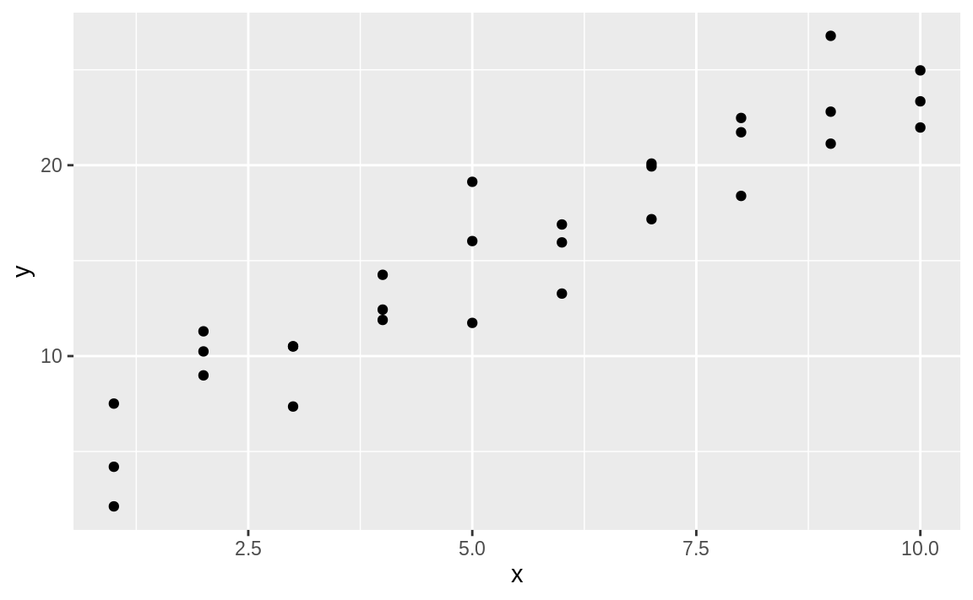
A simple model
ggplot(sim1, aes(x, y)) + geom_point()
Notes:
Lets take a look at the simulated dataset sim1, included with the modelr package. It contains two continuous variables, x and y. Let’s plot them to see how they’re related:
You can see a strong pattern in the data. Let’s use a model to capture that pattern and make it explicit.

Slide 10
A simple model
models <- tibble(
a1 = runif(250, -20, 40),
a2 = runif(250, -5, 5)
)
ggplot(sim1, aes(x, y)) +
geom_abline(aes(intercept = a1, slope = a2), data = models, alpha = 1/4) +
geom_point()
Notes:
It’s our job to supply the basic form of the model. In this case, the relationship looks linear, i.e. y = a_0 + a_1 * x. Let’s start by getting a feel for what models from that family look like by randomly generating a few and overlaying them on the data. For this simple case, we can use geom_abline() which takes a slope and intercept as parameters. Later on we’ll learn more general techniques that work with any model.

Slide 11
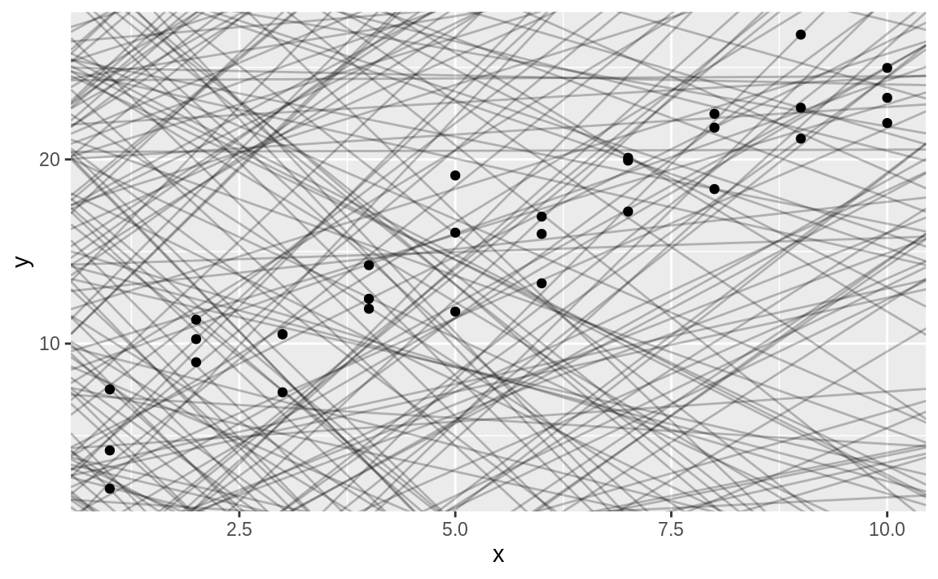
Notes:
There are 250 models on this plot, but a lot are really bad! We need to find the good models by making precise our intuition that a good model is “close” to the data. We need a way to quantify the distance between the data and a model. Then we can fit the model by finding the value of a_0 and a_1 that generate the model with the smallest distance from this data.

Slide 12
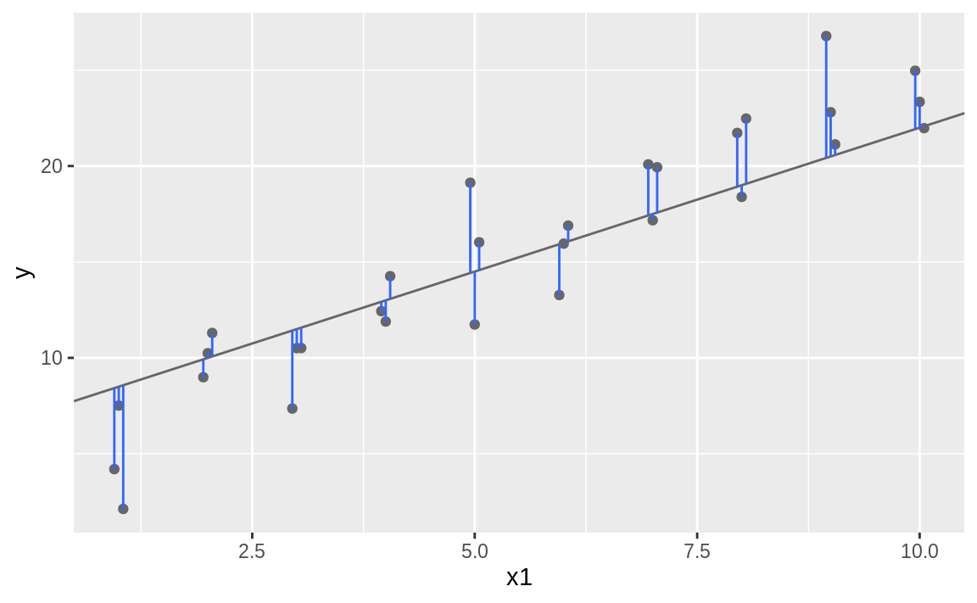

$$y_{i}− \hat{y}$$
Notes:
One easy place to start is to find the vertical distance between each point and the model, as in the following diagram. (Note that I’ve shifted the x values slightly so you can see the individual distances.)
This distance is just the difference between the y value given by the model (the prediction), and the actual y value in the data (the response).

Slide 13
compute this distance
model1 <- function(a, data) {
a[1] + data$x * a[2]
}
model1(c(7, 1.5), sim1)
#> [1] 8.5 8.5 8.5 10.0 10.0 10.0 11.5 11.5 11.5 13.0 13.0 13.0
#> [13] 14.5 14.5 14.5 16.0 16.0 16.0 17.5 17.5 17.5 19.0 19.0
#> [24] 19.0 20.5 20.5 20.5 22.0 22.0 22.0
Notes:
To compute this distance, we first turn our model family into an R function. This takes the model parameters and the data as inputs, and gives values predicted by the model as output:
Next, we need some way to compute an overall distance between the predicted and actual values. In other words, the plot above shows 30 distances: how do we collapse that into a single number?

Slide 14
rmse
measure_distance <- function(mod, data) {
diff <- data$y - model1(mod, data)
sqrt(mean(diff ^ 2))
}
measure_distance(c(7, 1.5), sim1)
#> [1] 2.67
Notes:
One common way to do this in statistics to use the “root-mean-squared deviation”. We compute the difference between actual and predicted, square them, average them, and the take the square root. This distance has lots of appealing mathematical properties, which we’re not going to talk about here. You’ll just have to take my word for it!

Slide 15
purrr
sim1_dist <- function(a1, a2) {
measure_distance(c(a1, a2), sim1)
}
models <- models %>%
mutate(dist = purrr::map2_dbl(a1, a2, sim1_dist))
models #> # A tibble: 250 x 3
#> a1 a2 dist
#> <dbl> <dbl> <dbl>
#> 1 -15.2 0.0889 30.8
#> 2 30.1 -0.827 13.2
#> 3 16.0 2.27 13.2
#> 4 -10.6 1.38 18.7
#> 5 -19.6 -1.04 41.8
#> 6 7.98 4.59 19.3
#> # … with 244 more rows
Notes:
Now we can use purrr to compute the distance for all the models defined above. We need a helper function because our distance function expects the model as a numeric vector of length 2.

Slide 16
10 best models
ggplot(sim1, aes(x, y)) +
geom_point(size = 2, colour = "grey30") +
geom_abline(
aes(intercept = a1, slope = a2, colour = -dist),
data = filter(models, rank(dist) <= 10)
)
Notes:
Next, let’s overlay the 10 best models on to the data. I’ve coloured the models by -dist: this is an easy way to make sure that the best models (i.e. the ones with the smallest distance) get the brighest colours.

Slide 17
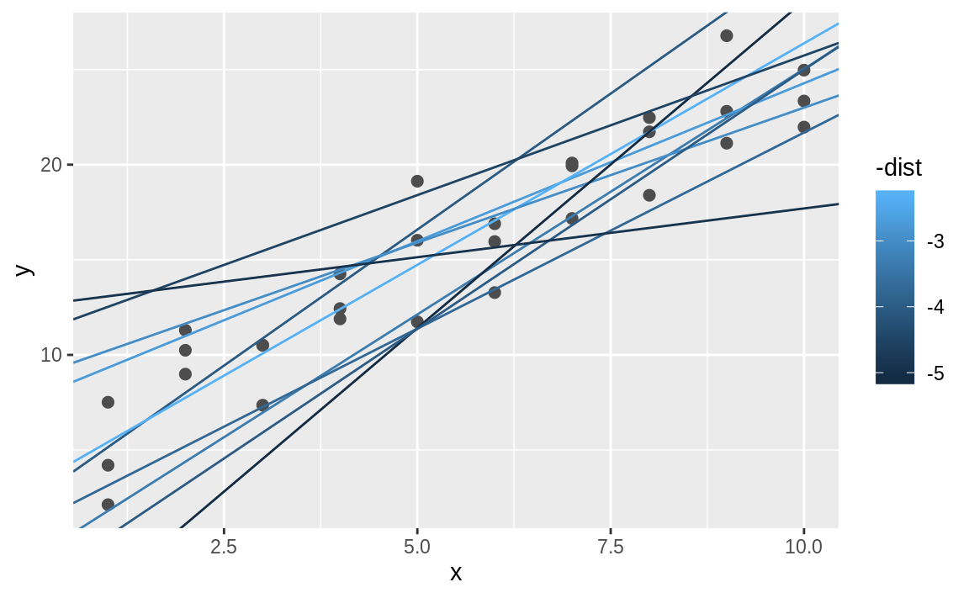
Notes:
this is an easy way to make sure that the best models (i.e. the ones with the smallest distance) get the brighest colours.

Slide 18
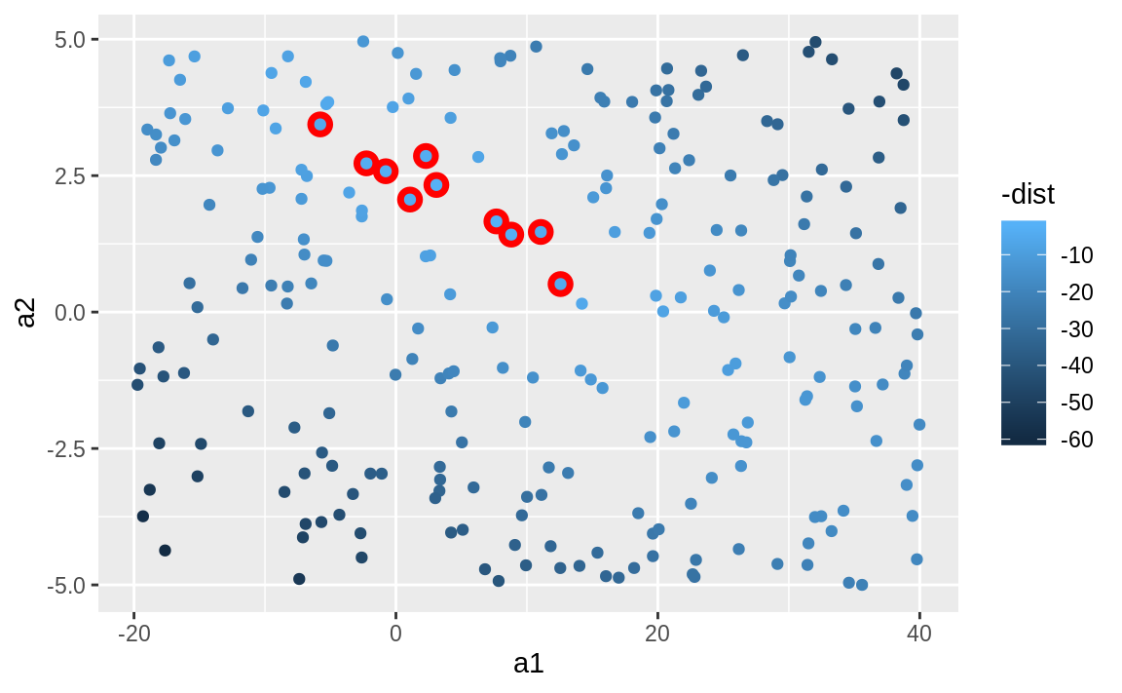
10 best models
ggplot(models, aes(a1, a2)) +
geom_point(data = filter(models, rank(dist) <= 10), size = 4, colour = "red") +
geom_point(aes(colour = -dist))
Notes:
We can also think about these models as observations, and visualising with a scatterplot of a1 vs a2, again coloured by -dist. We can no longer directly see how the model compares to the data, but we can see many models at once. Again, I’ve highlighted the 10 best models, this time by drawing red circles underneath them.

Slide 19
Generate grid
grid <- expand.grid(
a1 = seq(-5, 20, length = 25),
a2 = seq(1, 3, length = 25)
) %>%
mutate(dist = purrr::map2_dbl(a1, a2, sim1_dist))
grid %>%
ggplot(aes(a1, a2)) +
geom_point(data = filter(grid, rank(dist) <= 10), size = 4, colour = "red") +
geom_point(aes(colour = -dist))
Notes:
Instead of trying lots of random models, we could be more systematic and generate an evenly spaced grid of points (this is called a grid search).

Slide 20
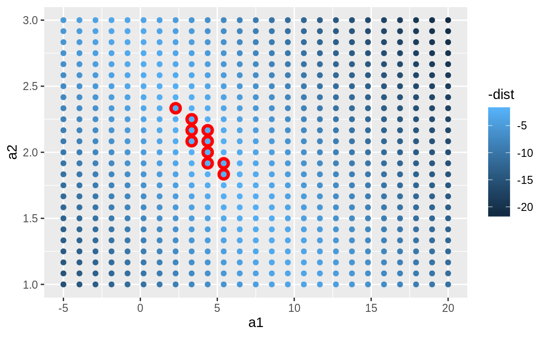
Notes:
I picked the parameters of the grid roughly by looking at where the best models were in the plot above.

Slide 21
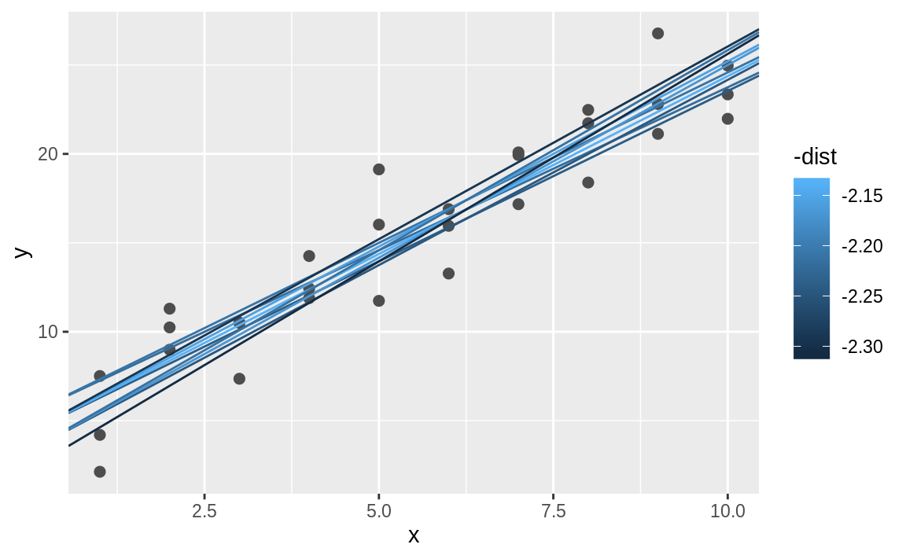
10 best models
ggplot(sim1, aes(x, y)) +
geom_point(size = 2, colour = "grey30") +
geom_abline(
aes(intercept = a1, slope = a2, colour = -dist),
data = filter(grid, rank(dist) <= 10) )
Notes:
You could imagine iteratively making the grid finer and finer until you narrowed in on the best model. But there’s a better way to tackle that problem: a numerical minimisation tool called Newton-Raphson search.

Slide 22
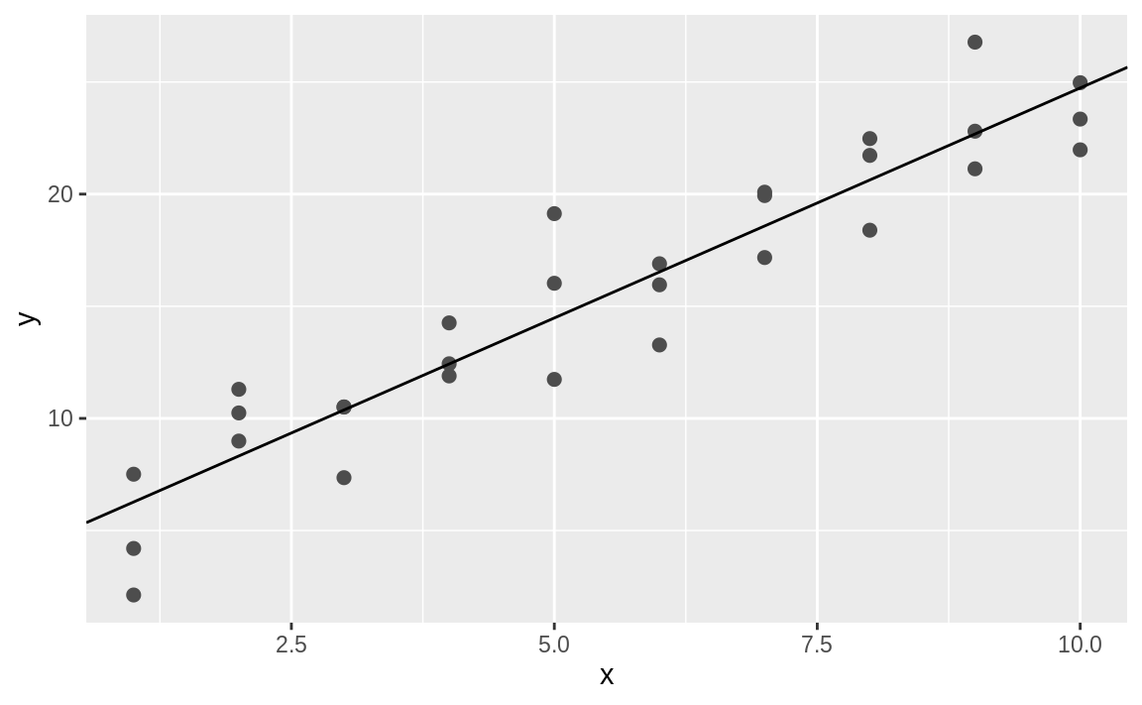
Optim()
best <- optim(c(0, 0), measure_distance, data = sim1)
best$par #> [1] 4.22 2.05
ggplot(sim1, aes(x, y)) +
geom_point(size = 2, colour = "grey30") +
geom_abline(intercept = best$par[1], slope = best$par[2])
Notes:
The intuition of Newton-Raphson is pretty simple: you pick a starting point and look around for the steepest slope. You then ski down that slope a little way, and then repeat again and again, until you can’t go any lower. In R, we can do that with optim():
Don’t worry too much about the details of how optim() works. It’s the intuition that’s important here. If you have a function that defines the distance between a model and a dataset, an algorithm that can minimise that distance by modifying the parameters of the model, you can find the best model. The neat thing about this approach is that it will work for any family of models that you can write an equation for.

Slide 23
Lm()
sim1_mod <- lm(y ~ x, data = sim1)
coef(sim1_mod)
#> (Intercept) x
#> 4.22 2.05
Notes:
There’s one more approach that we can use for this model, because it’s a special case of a broader family: linear models. A linear model has the general form y = a_1 + a_2 * x_1 + a_3 * x_2 + ... + a_n * x_(n - 1). So this simple model is equivalent to a general linear model where n is 2 and x_1 is x. R has a tool specifically designed for fitting linear models called lm(). lm() has a special way to specify the model family: formulas. Formulas look like y ~ x, which lm() will translate to a function like y = a_1 + a_2 * x. We can fit the model and look at the output:
These are exactly the same values we got with optim()! Behind the scenes lm() doesn’t use optim() but instead takes advantage of the mathematical structure of linear models. Using some connections between geometry, calculus, and linear algebra, lm() actually finds the closest model in a single step, using a sophisticated algorithm. This approach is both faster, and guarantees that there is a global minimum.

Slide 24
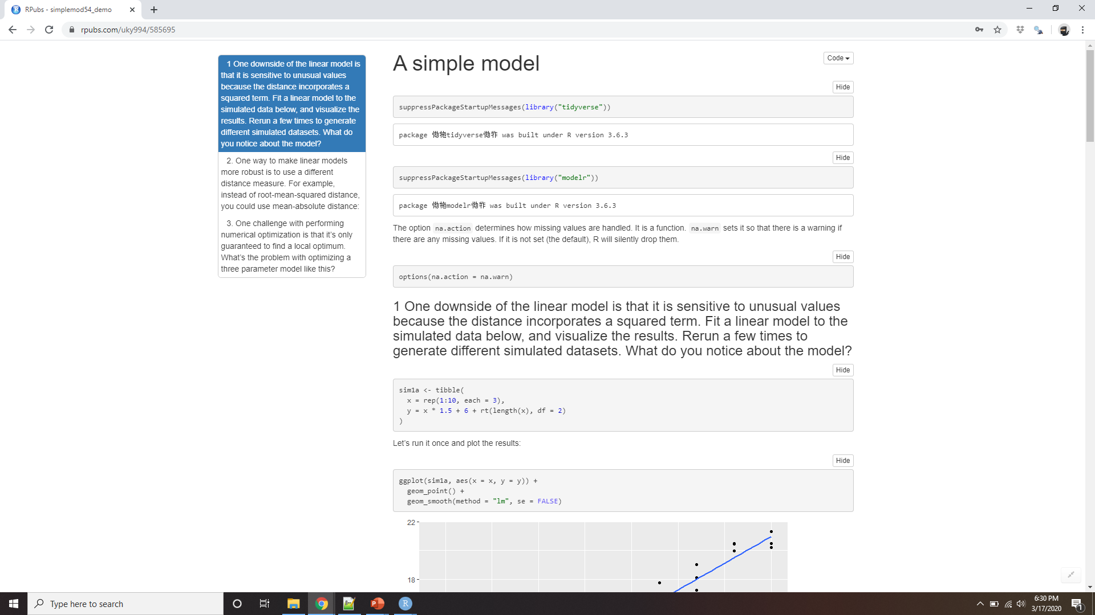
Demo a simple model
Notes:
https://rpubs.com/uky994/585695
One downside of the linear model is that it is sensitive to unusual values because the distance incorporates a squared term. Fit a linear model to the simulated data below, and visualise the results. Rerun a few times to generate different simulated datasets. What do you notice about the model?
sim1a <- tibble( x = rep(1:10, each = 3), y = x * 1.5 + 6 + rt(length(x), df = 2) )
One way to make linear models more robust is to use a different distance measure. For example, instead of root-mean-squared distance, you could use mean-absolute distance:
measure_distance <- function(mod, data) { diff <- data$y - model1(mod, data) mean(abs(diff)) }
Use optim() to fit this model to the simulated data above and compare it to the linear model.
One challenge with performing numerical optimisation is that it’s only guaranteed to find one local optimum. What’s the problem with optimising a three parameter model like this?
model1 <- function(a, data) { a[1] + data$x * a[2] + a[3] }

Slide 25
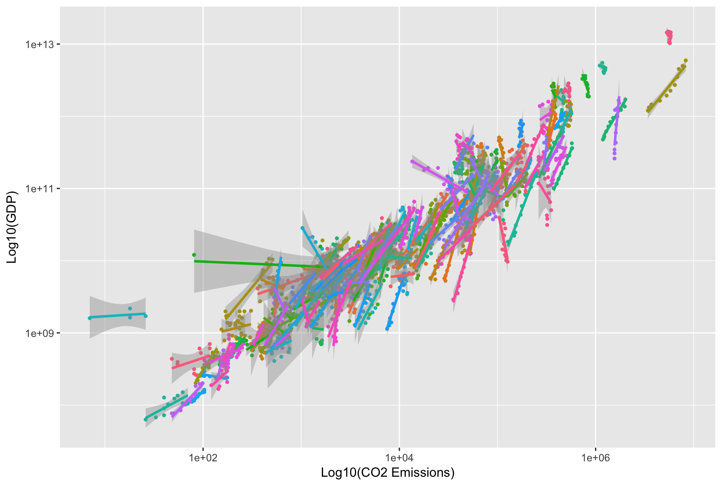
Visualising models
https://stats.stackexchange.com/questions/275103/visualizing-a-multilevel-model-hlm-in-ggplot2
Notes:
For simple models, like the one above, you can figure out what pattern the model captures by carefully studying the model family and the fitted coefficients. And if you ever take a statistics course on modelling, you’re likely to spend a lot of time doing just that. Here, however, we’re going to take a different tack. We’re going to focus on understanding a model by looking at its predictions. This has a big advantage: every type of predictive model makes predictions (otherwise what use would it be?) so we can use the same set of techniques to understand any type of predictive model.
It’s also useful to see what the model doesn’t capture, the so-called residuals which are left after subtracting the predictions from the data. Residuals are powerful because they allow us to use models to remove striking patterns so we can study the subtler trends that remain.

Slide 26
Predictions
grid <- sim1 %>%
data_grid(x)
grid
#> # A tibble: 10 x 1
#> x
#> <int>
#> 1 1
#> 2 2
#> 3 3
#> 4 4
#> 5 5
#> 6 6
#> # … with 4 more rows
Notes:
To visualise the predictions from a model, we start by generating an evenly spaced grid of values that covers the region where our data lies. The easiest way to do that is to use modelr::data_grid(). Its first argument is a data frame, and for each subsequent argument it finds the unique variables and then generates all combinations:
(This will get more interesting when we start to add more variables to our model.)

Slide 27
modelr::add_predictions()
grid <- grid %>%
add_predictions(sim1_mod)
grid
#> # A tibble: 10 x 2
#> x pred
#> <int> <dbl>
#> 1 1 6.27
#> 2 2 8.32
#> 3 3 10.4
#> 4 4 12.4
#> 5 5 14.5
#> 6 6 16.5
#> # … with 4 more rows
Notes:
Next we add predictions. We’ll use modelr::add_predictions() which takes a data frame and a model. It adds the predictions from the model to a new column in the data frame:
(You can also use this function to add predictions to your original dataset.)

Slide 28
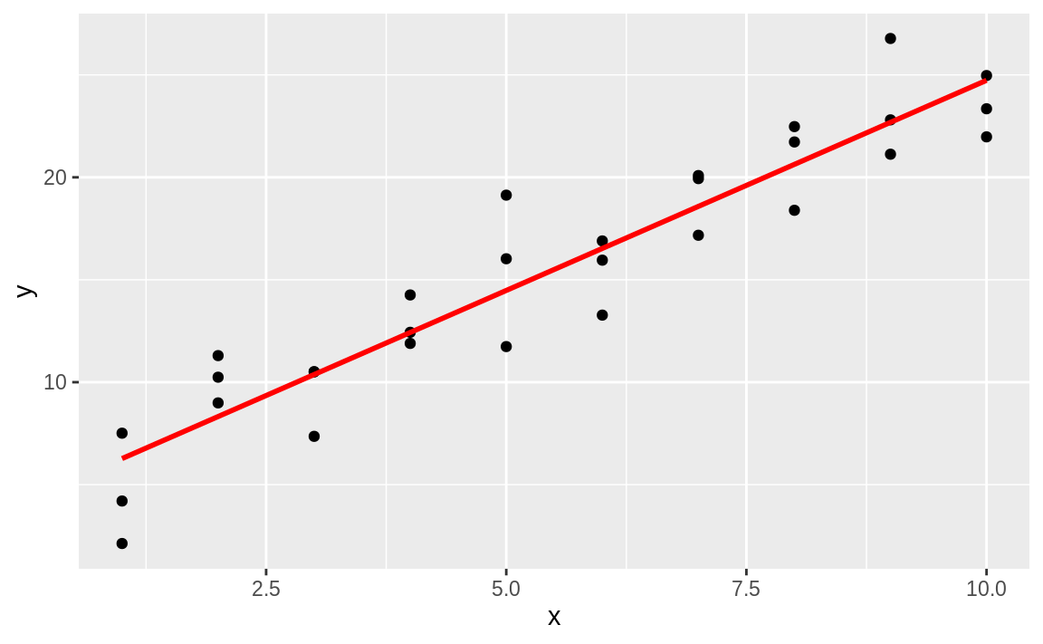
geom_abline()
ggplot(sim1, aes(x)) +
geom_point(aes(y = y)) +
geom_line(aes(y = pred), data = grid, colour = "red", size = 1)
http://vita.had.co.nz/papers/model-vis.html.
Notes:
Next, we plot the predictions. You might wonder about all this extra work compared to just using geom_abline(). But the advantage of this approach is that it will work with any model in R, from the simplest to the most complex. You’re only limited by your visualisation skills. For more ideas about how to visualise more complex model types, you might try http://vita.had.co.nz/papers/model-vis.html.

Slide 29
Residuals
sim1 <- sim1 %>%
add_residuals(sim1_mod)
sim1
#> # A tibble: 30 x 3
#> x y resid
#> <int> <dbl> <dbl>
#> 1 1 4.20 -2.07
#> 2 1 7.51 1.24
#> 3 1 2.13 -4.15
#> 4 2 8.99 0.665
#> 5 2 10.2 1.92
#> 6 2 11.3 2.97
#> # … with 24 more rows
Notes:
The flip-side of predictions are residuals. The predictions tells you the pattern that the model has captured, and the residuals tell you what the model has missed. The residuals are just the distances between the observed and predicted values that we computed above.
We add residuals to the data with add_residuals(), which works much like add_predictions(). Note, however, that we use the original dataset, not a manufactured grid. This is because to compute residuals we need actual y values.

Slide 30
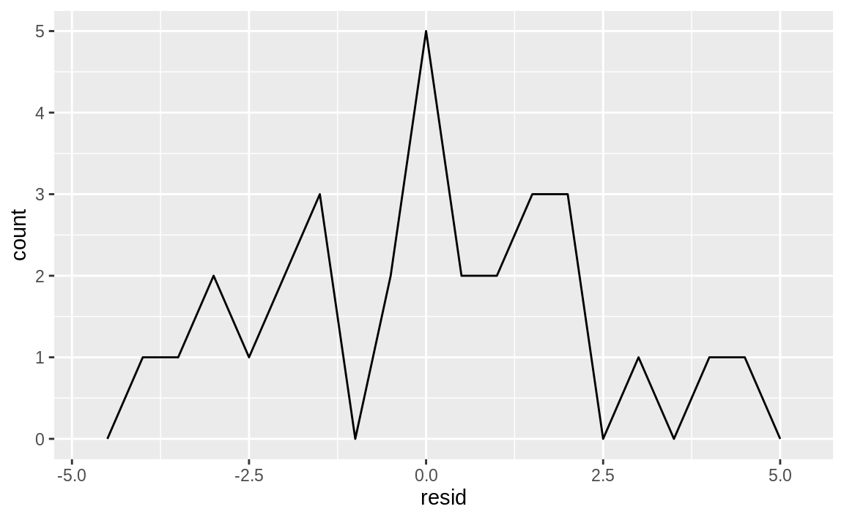
Residual frequency
ggplot(sim1, aes(resid)) + geom_freqpoly(binwidth = 0.5)
Notes:
There are a few different ways to understand what the residuals tell us about the model. One way is to simply draw a frequency polygon to help us understand the spread of the residuals:

Slide 31
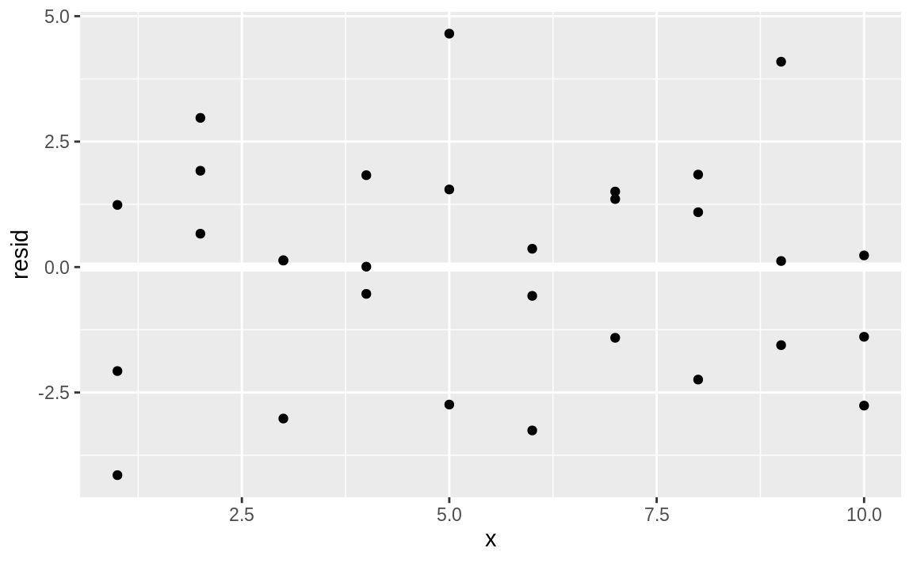
Residual plot
ggplot(sim1, aes(x, resid)) + geom_ref_line(h = 0) + geom_point()
Notes:
This helps you calibrate the quality of the model: how far away are the predictions from the observed values? Note that the average of the residual will always be 0.
You’ll often want to recreate plots using the residuals instead of the original predictor. You’ll see a lot of that in the next chapter.
This looks like random noise, suggesting that our model has done a good job of capturing the patterns in the dataset.

Slide 32
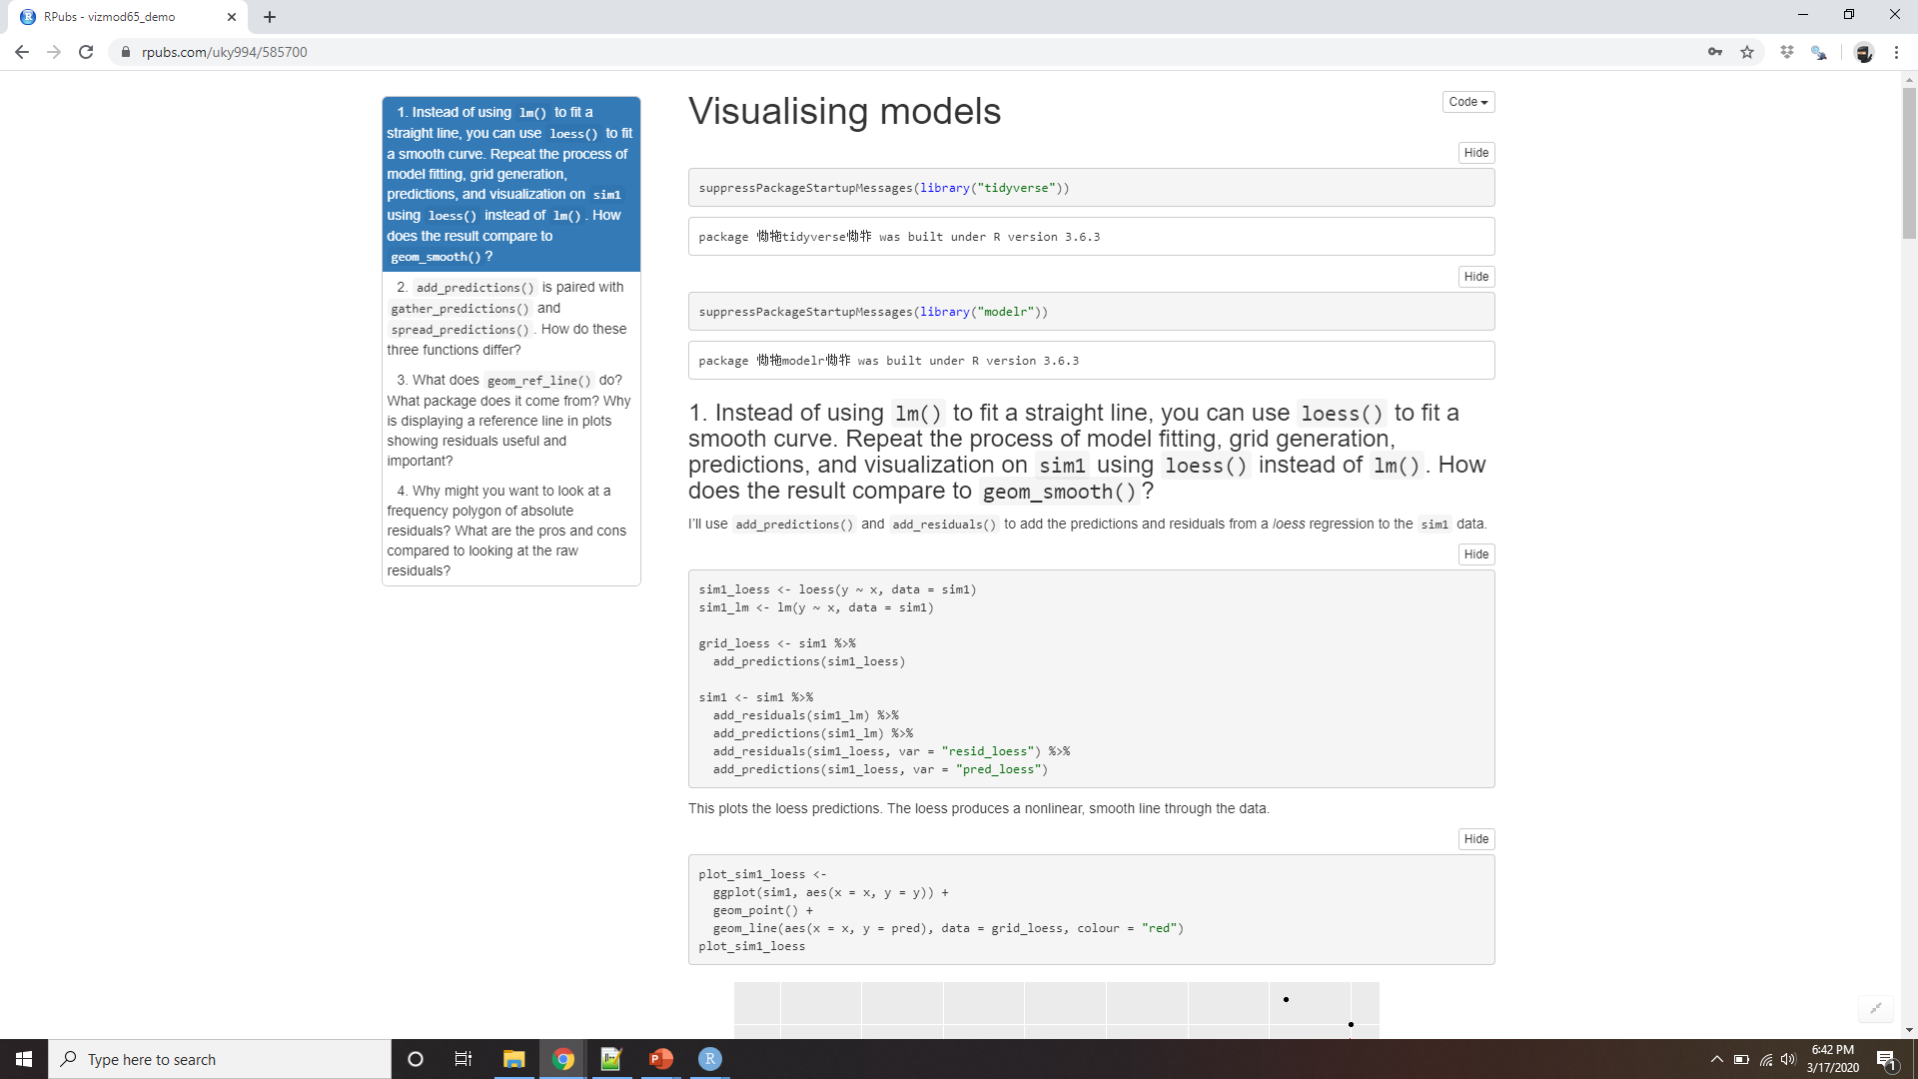
Demo Visualizing models
Notes:
https://rpubs.com/uky994/585700
Instead of using lm() to fit a straight line, you can use loess() to fit a smooth curve. Repeat the process of model fitting, grid generation, predictions, and visualisation on sim1 using loess() instead of lm(). How does the result compare to geom_smooth()?
add_predictions() is paired with gather_predictions() and spread_predictions(). How do these three functions differ?
What does geom_ref_line() do? What package does it come from? Why is displaying a reference line in plots showing residuals useful and important?
Why might you want to look at a frequency polygon of absolute residuals? What are the pros and cons compared to looking at the raw residuals?

Slide 33
Formulas and model families
df <- tribble(
~y, ~x1, ~x2,
4, 2, 5,
5, 1, 6 )
model_matrix(df, y ~ x1)
#> # A tibble: 2 x 2
#> `(Intercept)` x1
#> <dbl> <dbl>
#> 1 1 2
#> 2 1 1
Notes:
You’ve seen formulas before when using facet_wrap() and facet_grid(). In R, formulas provide a general way of getting “special behaviour”. Rather than evaluating the values of the variables right away, they capture them so they can be interpreted by the function.
The majority of modelling functions in R use a standard conversion from formulas to functions. You’ve seen one simple conversion already: y ~ x is translated to y = a_1 + a_2 * x. If you want to see what R actually does, you can use the model_matrix() function. It takes a data frame and a formula and returns a tibble that defines the model equation: each column in the output is associated with one coefficient in the model, the function is always y = a_1 * out1 + a_2 * out_2. For the simplest case of y ~ x1 this shows us something interesting:

Slide 34
No intercept
model_matrix(df, y ~ x1 - 1)
#> # A tibble: 2 x 1
#> x1
#> <dbl>
#> 1 2
#> 2 1
model_matrix(df, y ~ x1 + x2)
#> # A tibble: 2 x 3
#> `(Intercept)` x1 x2
#> <dbl> <dbl> <dbl>
#> 1 1 2 5
#> 2 1 1 6
Wilkinson-Rogers notation: https://www.jstor.org/stable/2346786
Notes:
The way that R adds the intercept to the model is just by having a column that is full of ones. By default, R will always add this column. If you don’t want, you need to explicitly drop it with -1:
The model matrix grows in an unsurprising way when you add more variables to the the model:
This formula notation is sometimes called “Wilkinson-Rogers notation”, and was initially described in Symbolic Description of Factorial Models for Analysis of Variance, by G. N. Wilkinson and C. E. Rogers https://www.jstor.org/stable/2346786. It’s worth digging up and reading the original paper if you’d like to understand the full details of the modelling algebra.
The following sections expand on how this formula notation works for categorical variables, interactions, and transformation.

Slide 35
Categorical variables
df <- tribble(
~ sex, ~ response,
"male", 1,
"female", 2,
"male", 1
)
model_matrix(df, response ~ sex)
#> # A tibble: 3 x 2
#> `(Intercept)` sexmale
#> <dbl> <dbl>
#> 1 1 1
#> 2 1 0
#> 3 1 1
Notes:
Generating a function from a formula is straight forward when the predictor is continuous, but things get a bit more complicated when the predictor is categorical. Imagine you have a formula like y ~ sex, where sex could either be male or female. It doesn’t make sense to convert that to a formula like y = x_0 + x_1 * sex because sex isn’t a number - you can’t multiply it! Instead what R does is convert it to y = x_0 + x_1 * sex_male where sex_male is one if sex is male and zero otherwise:
You might wonder why R also doesn’t create a sexfemale column. The problem is that would create a column that is perfectly predictable based on the other columns (i.e. sexfemale = 1 - sexmale). Unfortunately the exact details of why this is a problem is beyond the scope of this book, but basically it creates a model family that is too flexible, and will have infinitely many models that are equally close to the data.

Slide 36
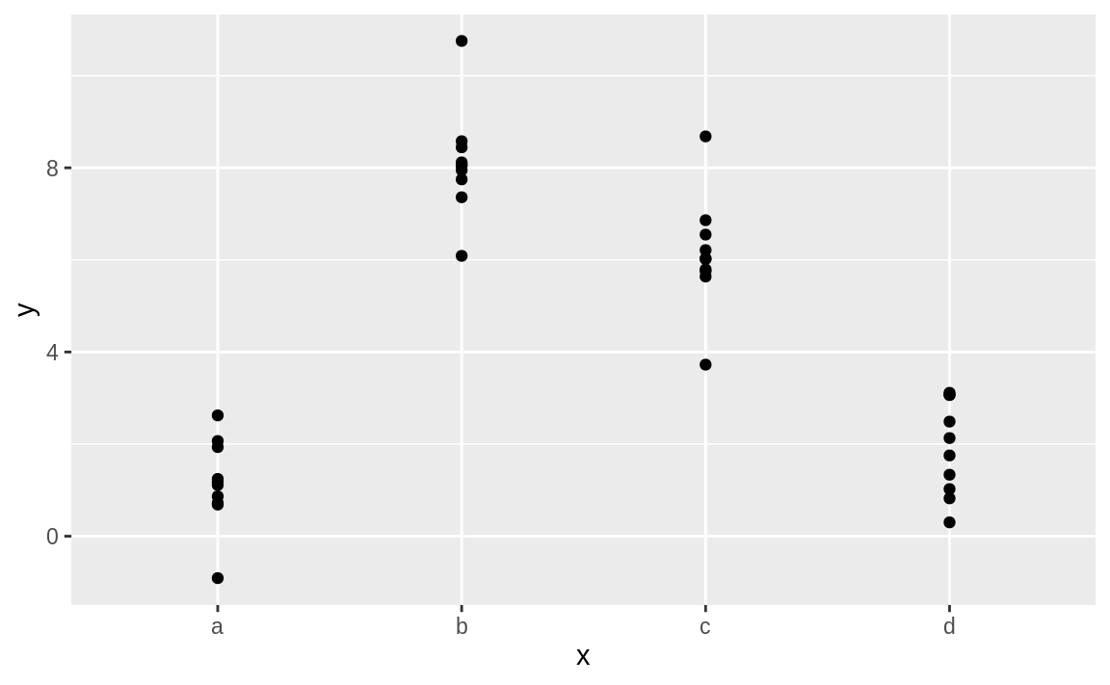
sim2 dataset from modelr
ggplot(sim2) + geom_point(aes(x, y))
Notes:
Fortunately, however, if you focus on visualising predictions you don’t need to worry about the exact parameterisation. Let’s look at some data and models to make that concrete. Here’s the sim2 dataset from modelr:
sim2 dataset from modelr

Slide 37
Fit a model
mod2 <- lm(y ~ x, data = sim2)
grid <- sim2 %>%
data_grid(x) %>%
add_predictions(mod2)
grid
#> # A tibble: 4 x 2
#> x pred
#> <chr> <dbl>
#> 1 a 1.15
#> 2 b 8.12
#> 3 c 6.13
#> 4 d 1.91
Notes:
We can fit a model to it, and generate predictions:

Slide 38
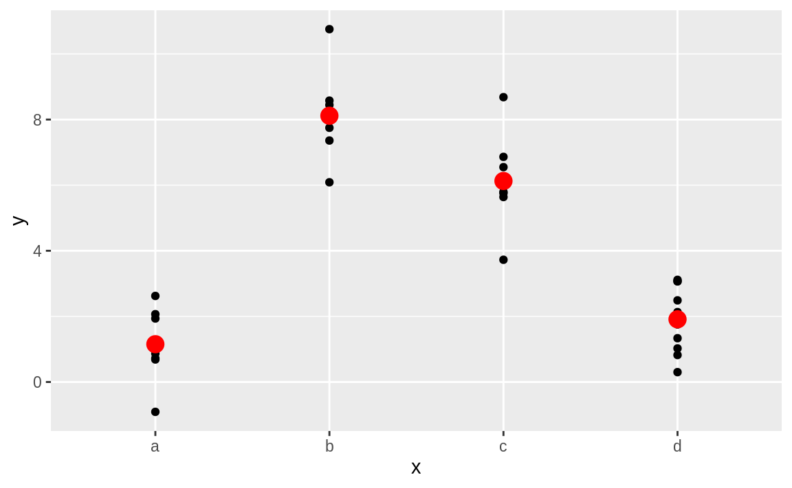
Predict mean value for each category
ggplot(sim2, aes(x)) +
geom_point(aes(y = y)) +
geom_point(data = grid, aes(y = pred), colour = "red", size = 4)
Notes:
Effectively, a model with a categorical x will predict the mean value for each category. (Why? Because the mean minimises the root-mean-squared distance.) That’s easy to see if we overlay the predictions on top of the original data:

Slide 39
Predictions on unobserved levels
tibble(x = "e") %>%
add_predictions(mod2)
#> Error in model.frame.default(Terms, newdata,
#> na.action = na.action, xlev = object$xlevels):
#> factor x has new level e
Notes:
You can’t make predictions about levels that you didn’t observe. Sometimes you’ll do this by accident so it’s good to recognise this error message

Slide 40
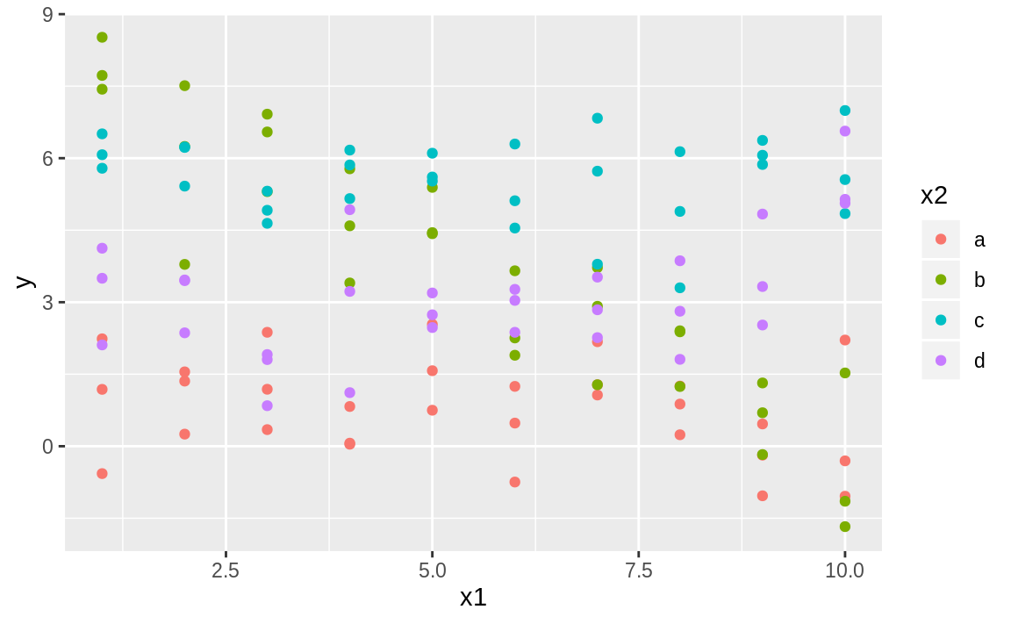
Interactions (continuous and categorical)
ggplot(sim3, aes(x1, y)) + geom_point(aes(colour = x2))
Notes:
What happens when you combine a continuous and a categorical variable? sim3 contains a categorical predictor and a continuous predictor. We can visualise it with a simple plot:

Slide 41
Fit models
mod1 <- lm(y ~ x1 + x2, data = sim3)
mod2 <- lm(y ~ x1 * x2, data = sim3)
interaction
y = a_0 + a_1 * x1 + a_2 * x2 + a_12 * x1 * x2.
individual components
interaction
Notes:
There are two possible models you could fit to this data:
When you add variables with +, the model will estimate each effect independent of all the others. It’s possible to fit the so-called interaction by using *. For example, y ~ x1 * x2 is translated to y = a_0 + a_1 * x1 + a_2 * x2 + a_12 * x1 * x2. Note that whenever you use *, both the interaction and the individual components are included in the model.

Slide 42
New tricks
We have two predictors, so we need to give data_grid() both variables. It finds all the unique values of x1 and x2 and then generates all combinations.
To generate predictions from both models simultaneously, we can use gather_predictions() which adds each prediction as a row. The complement of gather_predictions() is spread_predictions() which adds each prediction to a new column.
Notes:
To visualise these models we need two new tricks:
We have two predictors, so we need to give data_grid() both variables. It finds all the unique values of x1 and x2 and then generates all combinations.
To generate predictions from both models simultaneously, we can use gather_predictions() which adds each prediction as a row. The complement of gather_predictions() is spread_predictions() which adds each prediction to a new column.

Slide 43
This gives us
grid <- sim3 %>%
data_grid(x1, x2) %>%
gather_predictions(mod1, mod2)
grid
#> # A tibble: 80 x 4
#> model x1 x2 pred
#> <chr> <int> <fct> <dbl>
#> 1 mod1 1 a 1.67
#> 2 mod1 1 b 4.56
#> 3 mod1 1 c 6.48
#> 4 mod1 1 d 4.03
#> 5 mod1 2 a 1.48
#> 6 mod1 2 b 4.37
#> # … with 74 more rows
Notes:
Together this gives us:

Slide 44
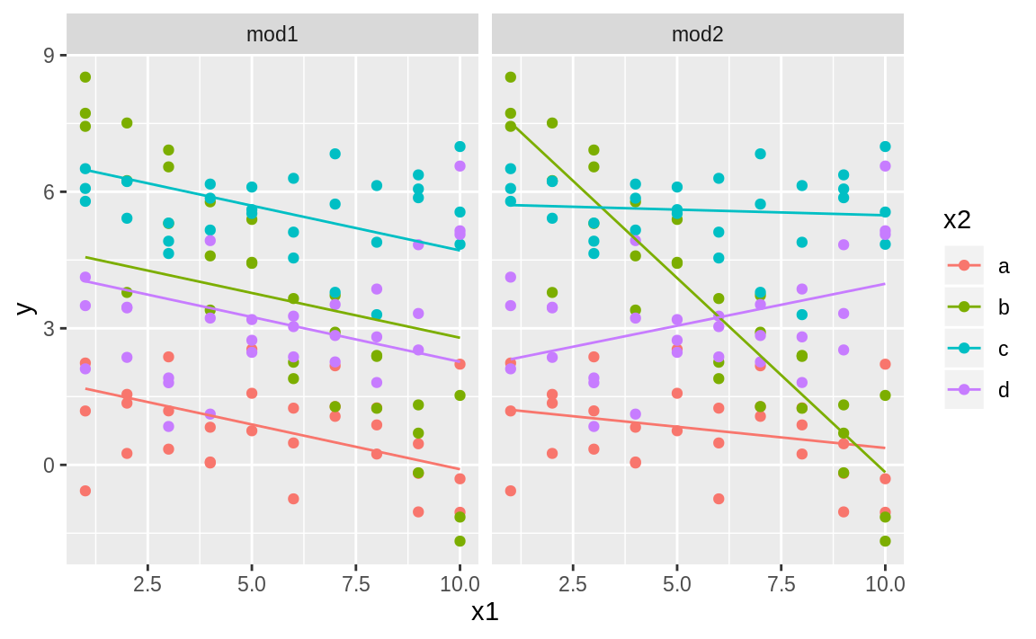
Plot using facetting
ggplot(sim3, aes(x1, y, colour = x2)) +
geom_point() +
geom_line(data = grid, aes(y = pred)) + facet_wrap(~ model)
Notes:
We can visualise the results for both models on one plot using facetting:
Note that the model that uses + has the same slope for each line, but different intercepts. The model that uses * has a different slope and intercept for each line.

Slide 45
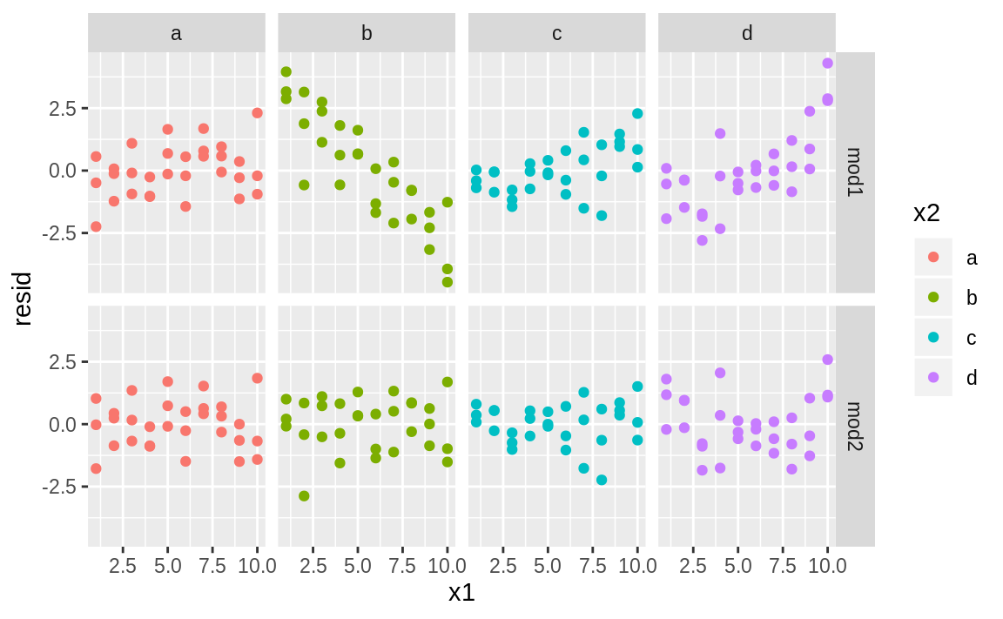
Residual plot
sim3 <- sim3 %>%
gather_residuals(mod1, mod2)
ggplot(sim3, aes(x1, resid, colour = x2)) +
geom_point() +
facet_grid(model ~ x2)
Notes:
Which model is better for this data? We can take look at the residuals. Here I’ve facetted by both model and x2 because it makes it easier to see the pattern within each group.
There is little obvious pattern in the residuals for mod2. The residuals for mod1 show that the model has clearly missed some pattern in b, and less so, but still present is pattern in c, and d. You might wonder if there’s a precise way to tell which of mod1 or mod2 is better. There is, but it requires a lot of mathematical background, and we don’t really care. Here, we’re interested in a qualitative assessment of whether or not the model has captured the pattern that we’re interested in.

Slide 46
Interactions (two continuous)
mod1 <- lm(y ~ x1 + x2, data = sim4)
mod2 <- lm(y ~ x1 * x2, data = sim4)
grid <- sim4 %>%
data_grid(
x1 = seq_range(x1, 5),
x2 = seq_range(x2, 5)
) %>%
gather_predictions(mod1, mod2)
grid
#> # A tibble: 50 x 4
#> model x1 x2 pred
#> <chr> <dbl> <dbl> <dbl>
#> 1 mod1 -1 -1 0.996
#> # … with 49 more rows
Notes:
Let’s take a look at the equivalent model for two continuous variables. Initially things proceed almost identically to the previous example:
Note my use of seq_range() inside data_grid(). Instead of using every unique value of x, I’m going to use a regularly spaced grid of five values between the minimum and maximum numbers. It’s probably not super important here, but it’s a useful technique in general. There are two other useful arguments to seq_range()

Slide 47
Pretty = true
seq_range(c(0.0123, 0.923423), n = 5)
#> [1] 0.0123 0.2401 0.4679 0.6956 0.9234
seq_range(c(0.0123, 0.923423), n = 5, pretty = TRUE)
#> [1] 0.0 0.2 0.4 0.6 0.8 1.0
Notes:
pretty = TRUE will generate a “pretty” sequence, i.e. something that looks nice to the human eye. This is useful if you want to produce tables of output:

Slide 48
Trim = 0.1
x1 <- rcauchy(100)
seq_range(x1, n = 5)
#> [1] -115.9 -83.5 -51.2 -18.8 13.5
seq_range(x1, n = 5, trim = 0.10)
#> [1] -13.84 -8.71 -3.58 1.55 6.68
seq_range(x1, n = 5, trim = 0.25)
#> [1] -2.1735 -1.0594 0.0547 1.1687 2.2828
seq_range(x1, n = 5, trim = 0.50)
#> [1] -0.725 -0.268 0.189 0.647 1.104
Notes:
trim = 0.1 will trim off 10% of the tail values. This is useful if the variables have a long tailed distribution and you want to focus on generating values near the center:

Slide 49
Expand =0.1
x2 <- c(0, 1) seq_range(x2, n = 5)
#> [1] 0.00 0.25 0.50 0.75 1.00
seq_range(x2, n = 5, expand = 0.10)
#> [1] -0.050 0.225 0.500 0.775 1.050
seq_range(x2, n = 5, expand = 0.25)
#> [1] -0.125 0.188 0.500 0.812 1.125
seq_range(x2, n = 5, expand = 0.50)
#> [1] -0.250 0.125 0.500 0.875 1.250
Notes:
expand = 0.1 is in some sense the opposite of trim() it expands the range by 10%.

Slide 50
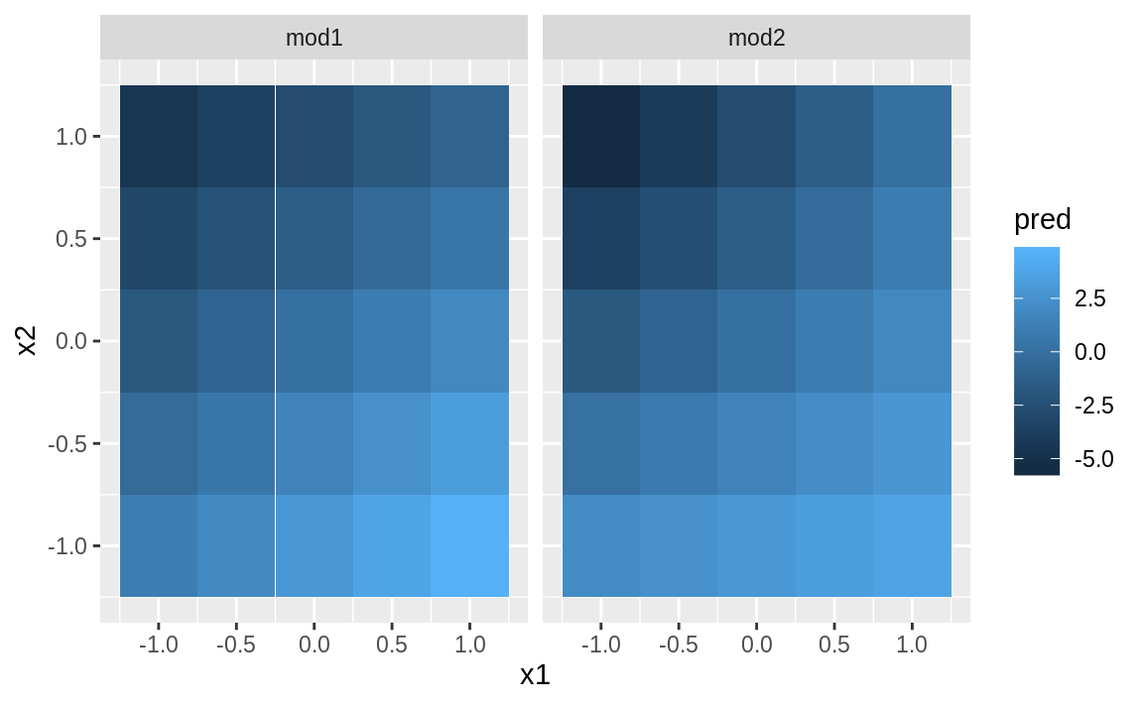
geom_tile()
ggplot(grid, aes(x1, x2)) +
geom_tile(aes(fill = pred)) +
facet_wrap(~ model)
Notes:
Next let’s try and visualise that model. We have two continuous predictors, so you can imagine the model like a 3d surface. We could display that using geom_tile():
That doesn’t suggest that the models are very different! But that’s partly an illusion: our eyes and brains are not very good at accurately comparing shades of colour.

Slide 51
Showing multiple slices
ggplot(grid, aes(x1, pred, colour = x2, group = x2)) +
geom_line() +
facet_wrap(~ model)
ggplot(grid, aes(x2, pred, colour = x1, group = x1)) +
geom_line() +
facet_wrap(~ model)
Notes:
Instead of looking at the surface from the top, we could look at it from either side, showing multiple slices:

Slide 52
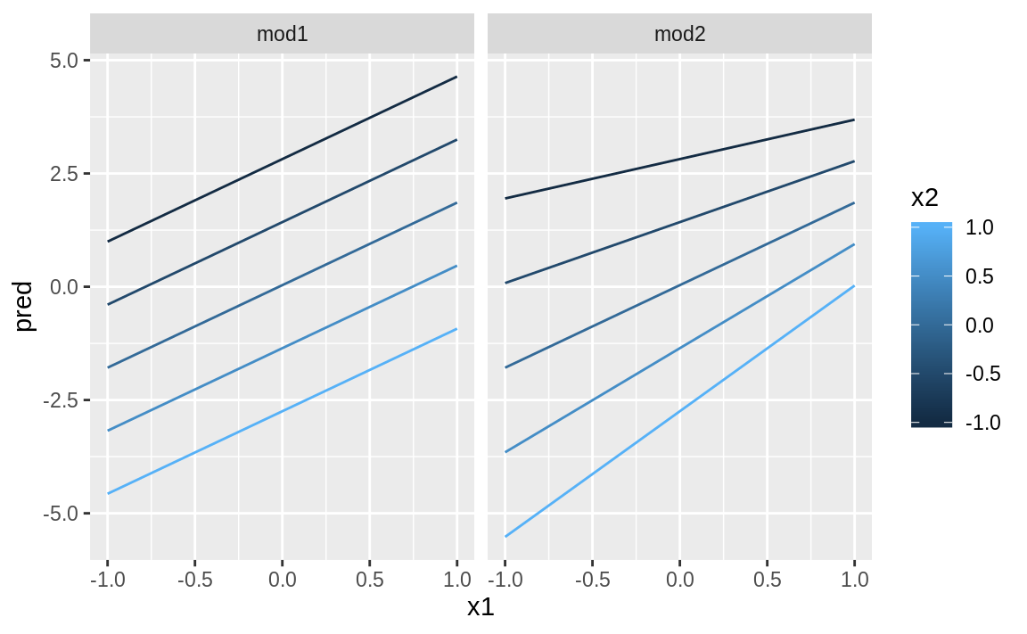
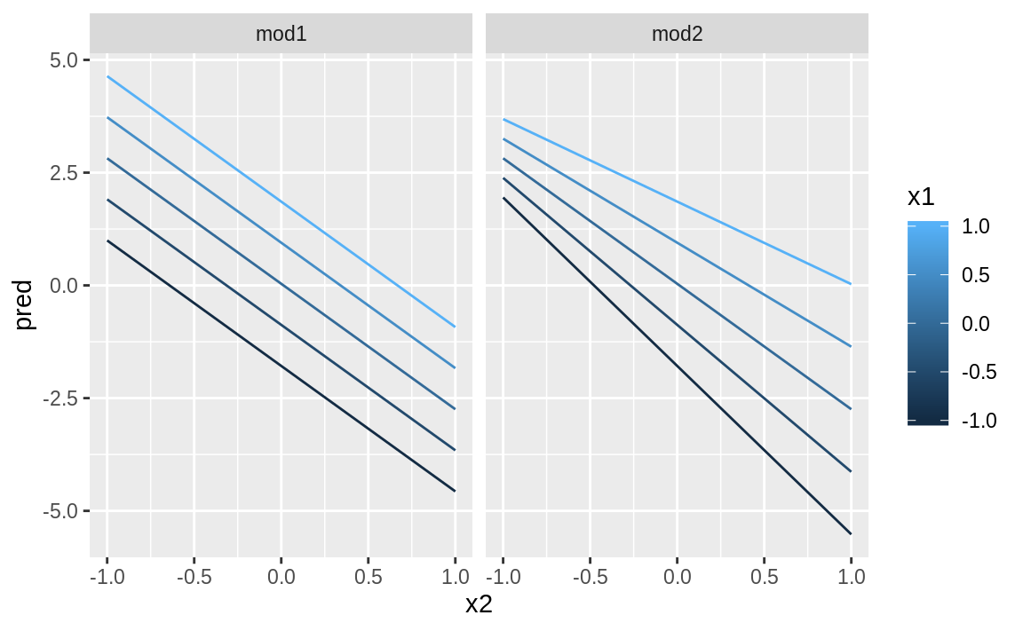
Showing multiple slices
Notes:
This shows you that interaction between two continuous variables works basically the same way as for a categorical and continuous variable. An interaction says that there’s not a fixed offset: you need to consider both values of x1 and x2 simultaneously in order to predict y.
You can see that even with just two continuous variables, coming up with good visualizations are hard. But that’s reasonable: you shouldn’t expect it will be easy to understand how three or more variables simultaneously interact! But again, we’re saved a little because we’re using models for exploration, and you can gradually build up your model over time. The model doesn’t have to be perfect, it just has to help you reveal a little more about your data.
I spent some time looking at the residuals to see if I could figure if mod2 did better than mod1. I think it does, but it’s pretty subtle. You’ll have a chance to work on it in the exercises.

Slide 53
Transformations
You can also perform transformations inside the model formula.
log(y) ~ sqrt(x1) + x2 becomes
log(y) = a_1 + a_2 * sqrt(x1) + a_3 * x2.
If your transformation involves +, *, ^, or -, you’ll need to wrap it in I()
y ~ x + I(x ^ 2) becomes y = a_1 + a_2 * x + a_3 * x^2.
If you forget the I() and specify y ~ x ^ 2 + x, R will compute y ~ x * x + x.
y ~ x ^ 2 + x specifies the function y = a_1 + a_2 * x.
That’s probably not what you want!
same as x
Notes:
You can also perform transformations inside the model formula. For example, log(y) ~ sqrt(x1) + x2 is transformed to log(y) = a_1 + a_2 * sqrt(x1) + a_3 * x2. If your transformation involves +, *, ^, or -, you’ll need to wrap it in I() so R doesn’t treat it like part of the model specification. For example, y ~ x + I(x ^ 2) is translated to y = a_1 + a_2 * x + a_3 * x^2. If you forget the I() and specify y ~ x ^ 2 + x, R will compute y ~ x * x + x. x * x means the interaction of x with itself, which is the same as x. R automatically drops redundant variables so x + x become x, meaning that y ~ x ^ 2 + x specifies the function y = a_1 + a_2 * x. That’s probably not what you intended!

Slide 54
Model_matrix()
df <- tribble( ~y, ~x, 1, 1, 2, 2, 3, 3 )
model_matrix(df, y ~ x^2 + x) #> # A tibble: 3 x 2
#> `(Intercept)` x
#> <dbl> <dbl>
#> 1 1 1
#> 2 1 2
#> 3 1 3
model_matrix(df, y ~ I(x^2) + x)
#> # A tibble: 3 x 3
#> `(Intercept)` `I(x^2)` x
#> <dbl> <dbl> <dbl>
#> 1 1 1 1
#> 2 1 4 2
#> 3 1 9 3
Notes:
Again, if you get confused about what your model is doing, you can always use model_matrix() to see exactly what equation lm() is fitting:

Slide 55
poly
model_matrix(df, y ~ poly(x, 2))
#> # A tibble: 3 x 3
#> `(Intercept)` `poly(x, 2)1` `poly(x, 2)2`
#> <dbl> <dbl> <dbl>
#> 1 1 -7.07e- 1 0.408
#> 2 1 -7.85e-17 -0.816
#> 3 1 7.07e- 1 0.408
Notes:
Transformations are useful because you can use them to approximate non-linear functions. If you’ve taken a calculus class, you may have heard of Taylor’s theorem which says you can approximate any smooth function with an infinite sum of polynomials. That means you can use a polynomial function to get arbitrarily close to a smooth function by fitting an equation like y = a_1 + a_2 * x + a_3 * x^2 + a_4 * x ^ 3. Typing that sequence by hand is tedious, so R provides a helper function: poly():

Slide 56
splines::ns()
library(splines)
model_matrix(df, y ~ ns(x, 2))
#> # A tibble: 3 x 3
#> `(Intercept)` `ns(x, 2)1` `ns(x, 2)2`
#> <dbl> <dbl> <dbl>
#> 1 1 0 0
#> 2 1 0.566 -0.211
#> 3 1 0.344 0.771
Notes:
However there’s one major problem with using poly(): outside the range of the data, polynomials rapidly shoot off to positive or negative infinity. One safer alternative is to use the natural spline, splines::ns().

Slide 57
approximate a non-linear function
sim5 <- tibble(
x = seq(0, 3.5 * pi, length = 50),
y = 4 * sin(x) + rnorm(length(x))
)
ggplot(sim5, aes(x, y)) +
geom_point()
Notes:
Let’s see what that looks like when we try and approximate a non-linear function:

Slide 58
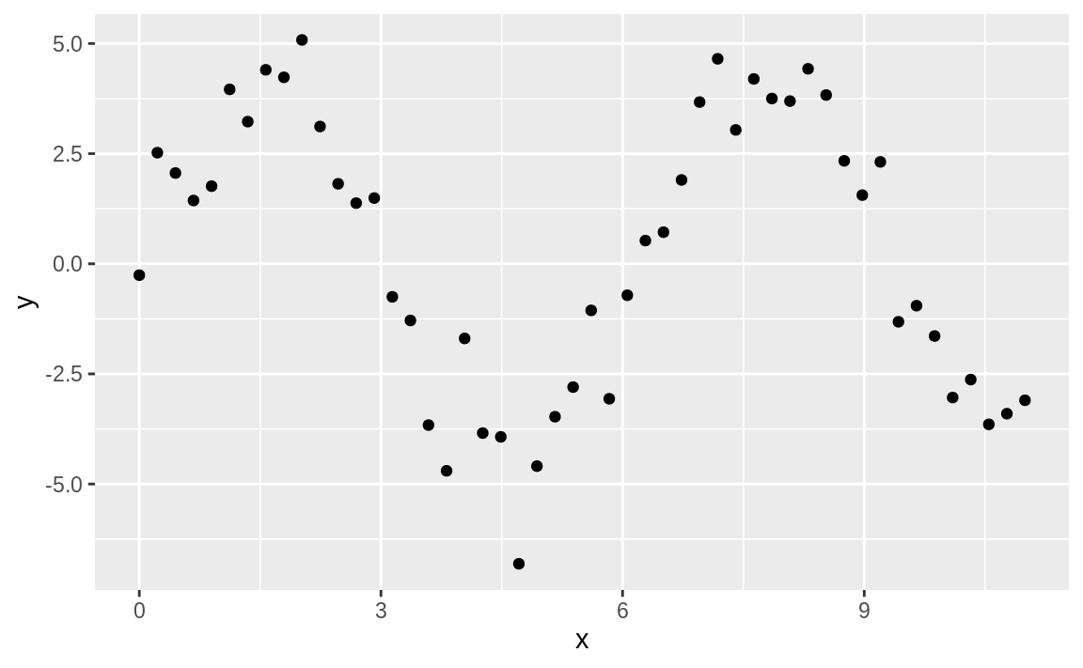
Notes:
I’m going to fit five models to this data.

Slide 59
Fit some models
mod1 <- lm(y ~ ns(x, 1), data = sim5)
mod2 <- lm(y ~ ns(x, 2), data = sim5)
mod3 <- lm(y ~ ns(x, 3), data = sim5)
mod4 <- lm(y ~ ns(x, 4), data = sim5)
mod5 <- lm(y ~ ns(x, 5), data = sim5)
grid <- sim5 %>%
data_grid(x = seq_range(x, n = 50, expand = 0.1)) %>%
gather_predictions(mod1, mod2, mod3, mod4, mod5, .pred = "y")
ggplot(sim5, aes(x, y)) +
geom_point() +
geom_line(data = grid, colour = "red") +
facet_wrap(~ model)

Slide 60
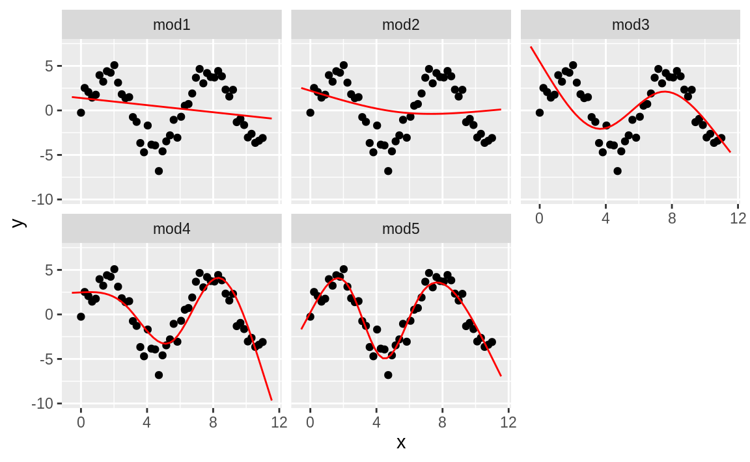
Notes:
Notice that the extrapolation outside the range of the data is clearly bad. This is the downside to approximating a function with a polynomial. But this is a very real problem with every model: the model can never tell you if the behaviour is true when you start extrapolating outside the range of the data that you have seen. You must rely on theory and science.

Slide 61
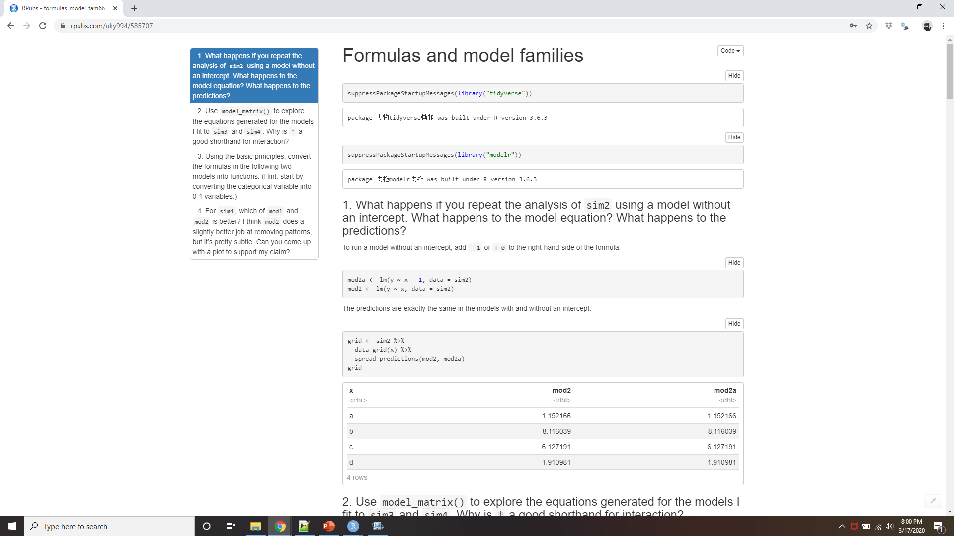
Demo Formulas and model families
Notes:
https://rpubs.com/uky994/585707
What happens if you repeat the analysis of sim2 using a model without an intercept. What happens to the model equation? What happens to the predictions?
Use model_matrix() to explore the equations generated for the models I fit to sim3 and sim4. Why is * a good shorthand for interaction?
Using the basic principles, convert the formulas in the following two models into functions. (Hint: start by converting the categorical variable into 0-1 variables.)
mod1 <- lm(y ~ x1 + x2, data = sim3) mod2 <- lm(y ~ x1 * x2, data = sim3)
For sim4, which of mod1 and mod2 is better? I think mod2 does a slightly better job at removing patterns, but it’s pretty subtle. Can you come up with a plot to support my claim?

Slide 62
Missing values
df <- tribble( ~x, ~y, 1, 2.2, 2, NA, 3, 3.5, 4, 8.3, NA, 10 )
mod <- lm(y ~ x, data = df)
#> Warning: Dropping 2 rows with missing values
mod <- lm(y ~ x, data = df, na.action = na.exclude)
nobs(mod)
#> [1] 3
Notes:
Missing values obviously can not convey any information about the relationship between the variables, so modelling functions will drop any rows that contain missing values. R’s default behaviour is to silently drop them, but options(na.action = na.warn) (run in the prerequisites), makes sure you get a warning.
To suppress the warning, set na.action = na.exclude:
You can always see exactly how many observations were used with nobs():

Slide 63
Other model families
Generalized linear models, e.g. stats::glm(). extend linear models to include non-continuous responses (e.g. binary data or counts).
Generalized additive models, e.g. mgcv::gam(), extend generalized linear models to incorporate arbitrary smooth functions.
Penalized linear models, e.g. glmnet::glmnet(), add a penalty term to the distance that penalizes complex models (as defined by the distance between the parameter vector and the origin).
Robust linear models, e.g. MASS::rlm(), tweak the distance to downweight points that are very far away.
Trees, e.g. rpart::rpart(), fit a piece-wise constant model, splitting the data into progressively smaller and smaller pieces. Trees are very powerful when used in aggregate by models like random forests (e.g. randomForest::randomForest()) or gradient boosting machines (e.g. xgboost::xgboost.)
Notes:
This chapter has focussed exclusively on the class of linear models, which assume a relationship of the form y = a_1 * x1 + a_2 * x2 + ... + a_n * xn. Linear models additionally assume that the residuals have a normal distribution, which we haven’t talked about. There are a large set of model classes that extend the linear model in various interesting ways. Some of them are:
Generalised linear models, e.g. stats::glm(). Linear models assume that the response is continuous and the error has a normal distribution. Generalised linear models extend linear models to include non-continuous responses (e.g. binary data or counts). They work by defining a distance metric based on the statistical idea of likelihood.
Generalised additive models, e.g. mgcv::gam(), extend generalised linear models to incorporate arbitrary smooth functions. That means you can write a formula like y ~ s(x) which becomes an equation like y = f(x) and let gam() estimate what that function is (subject to some smoothness constraints to make the problem tractable).
Penalised linear models, e.g. glmnet::glmnet(), add a penalty term to the distance that penalises complex models (as defined by the distance between the parameter vector and the origin). This tends to make models that generalise better to new datasets from the same population.
Robust linear models, e.g. MASS::rlm(), tweak the distance to downweight points that are very far away. This makes them less sensitive to the presence of outliers, at the cost of being not quite as good when there are no outliers.
Trees, e.g. rpart::rpart(), attack the problem in a completely different way than linear models. They fit a piece-wise constant model, splitting the data into progressively smaller and smaller pieces. Trees aren’t terribly effective by themselves, but they are very powerful when used in aggregate by models like random forests (e.g. randomForest::randomForest()) or gradient boosting machines (e.g. xgboost::xgboost.)
These models all work similarly from a programming perspective. Once you’ve mastered linear models, you should find it easy to master the mechanics of these other model classes. Being a skilled modeller is a mixture of some good general principles and having a big toolbox of techniques. Now that you’ve learned some general tools and one useful class of models, you can go on and learn more classes from other sources.

